Slide 1
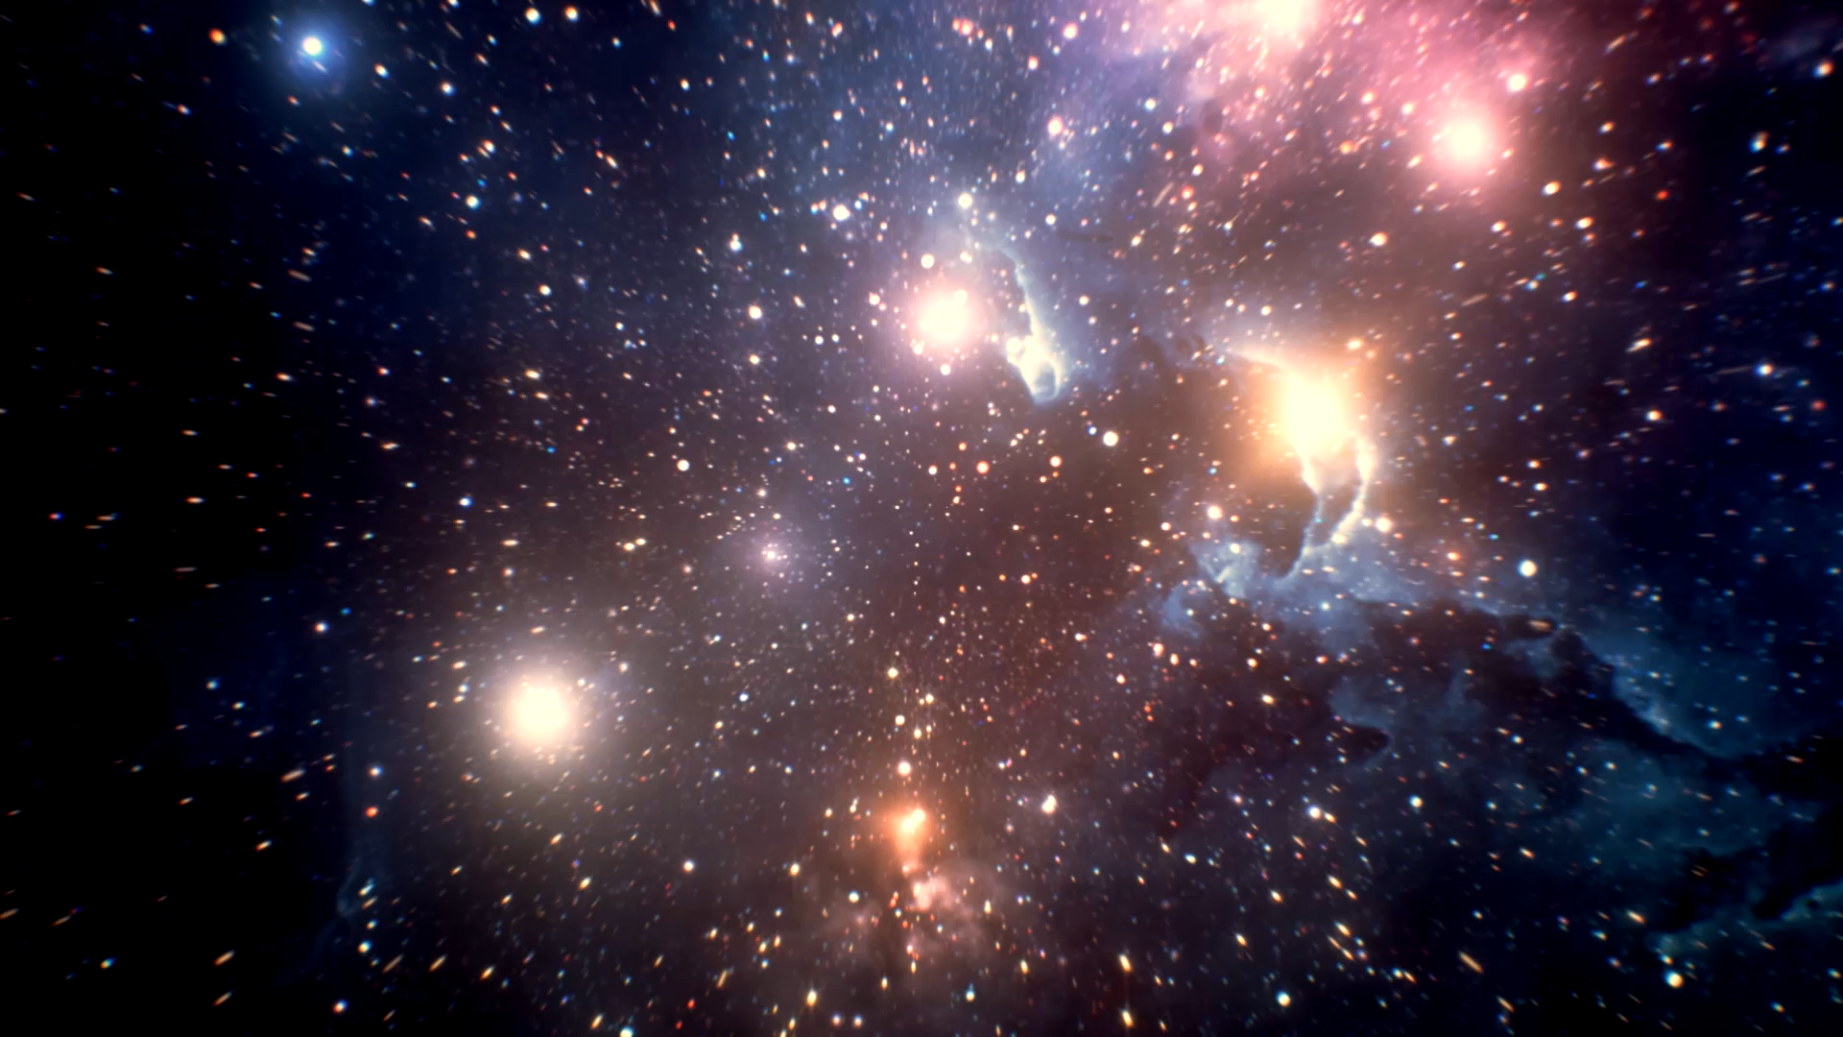
Galaxy
a system of millions or billions of stars, together with gas and dust, held together by gravitational attraction.

Slide 2
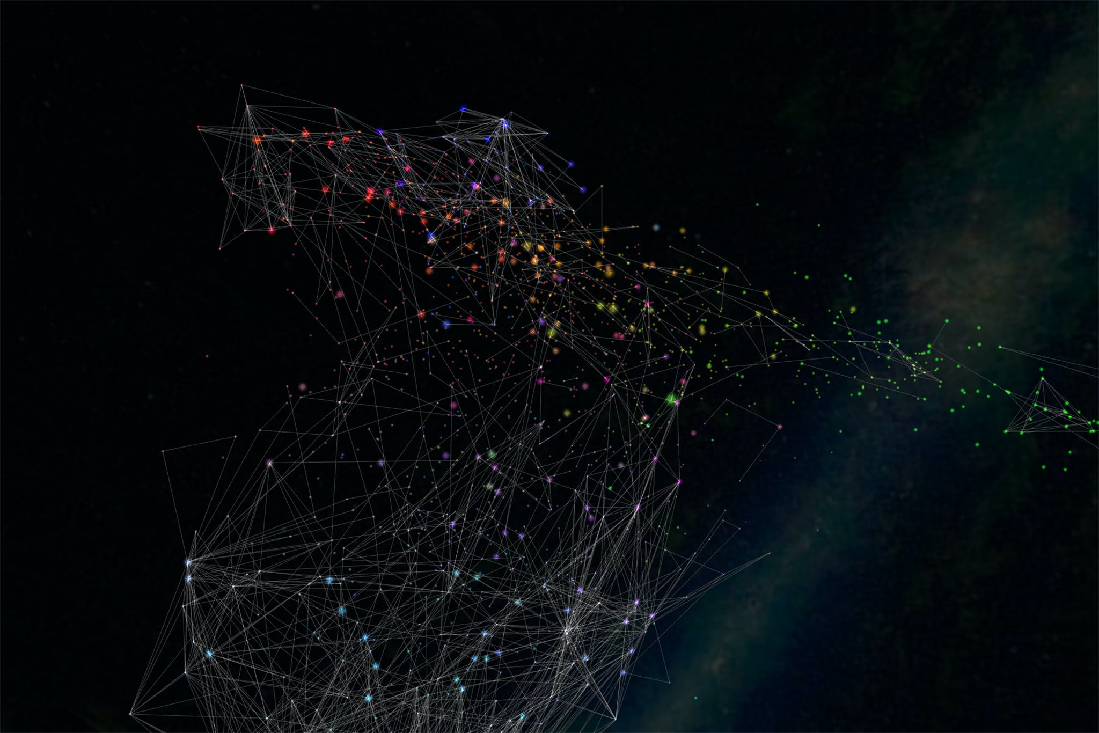
This image symbolizes an interconnected network of constellations
Notes:
We are all connected to each other in some sort of way, whether its through technology for example.

Slide 3
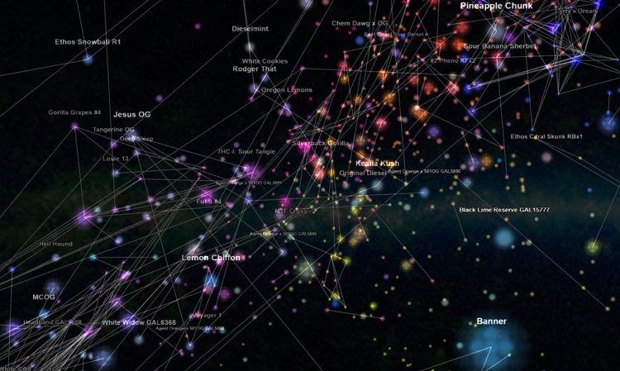
Idea for the magazine entails a network of different countries connected by stars. The stars represents individuals from each country

Slide 4
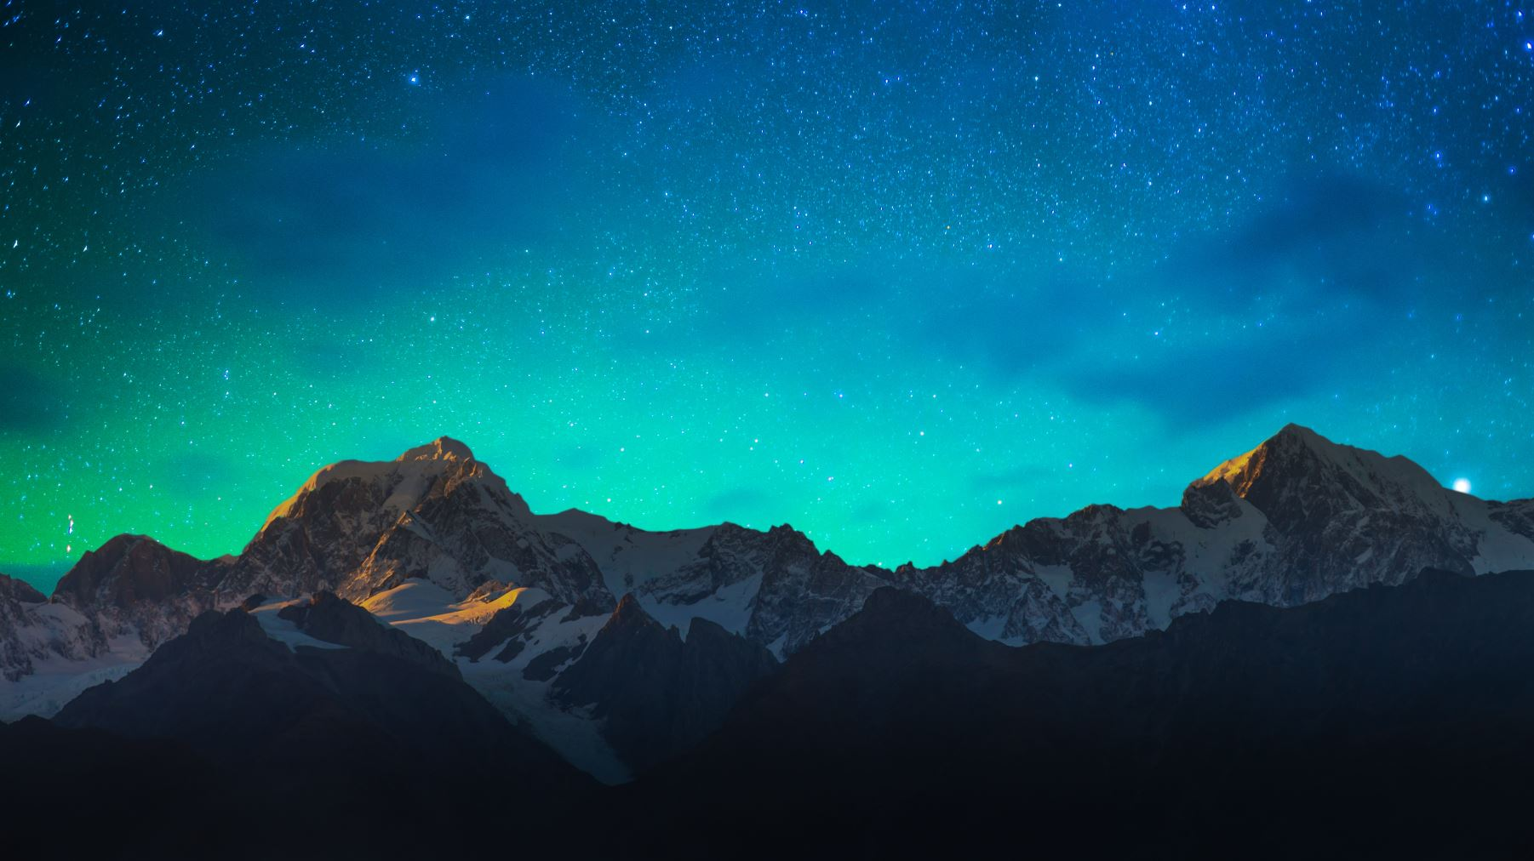
So, if “Galaxy” was the theme or name for a magazine, what should it represent?

Slide 5
First the image of a galaxy shows millions of stars. However, if we are looking at an image, we see the stars interconnected forming the galaxy. So the picture of the front page would kind of look like a edit image of a galaxy on a world map. And a single star should be placed on each country. represent the interconnected networks in this world. We are all connected in some way. The stars should represent each country in the world.
Second, the meaning behind the word galaxy should represent a few things. It obviously represents interconnected networks. A galaxy symbolizes infinity to a certain extent. A vast majority. This can be an idea for the magazine. Meaning you are open to all sorts of creativity. There is no limit. And that’s how people should feel. They need to feel accepted and know there are ENDLESS possibilities in this world. (Like a galaxy which is “kind of” never ending. We individuals are all connected in some way. Each star on each country should be a reference to everyone in that country. This allows everyone reading the magazine to relate to the magazine and be inspired by it to do creative things as well.

Slide 6
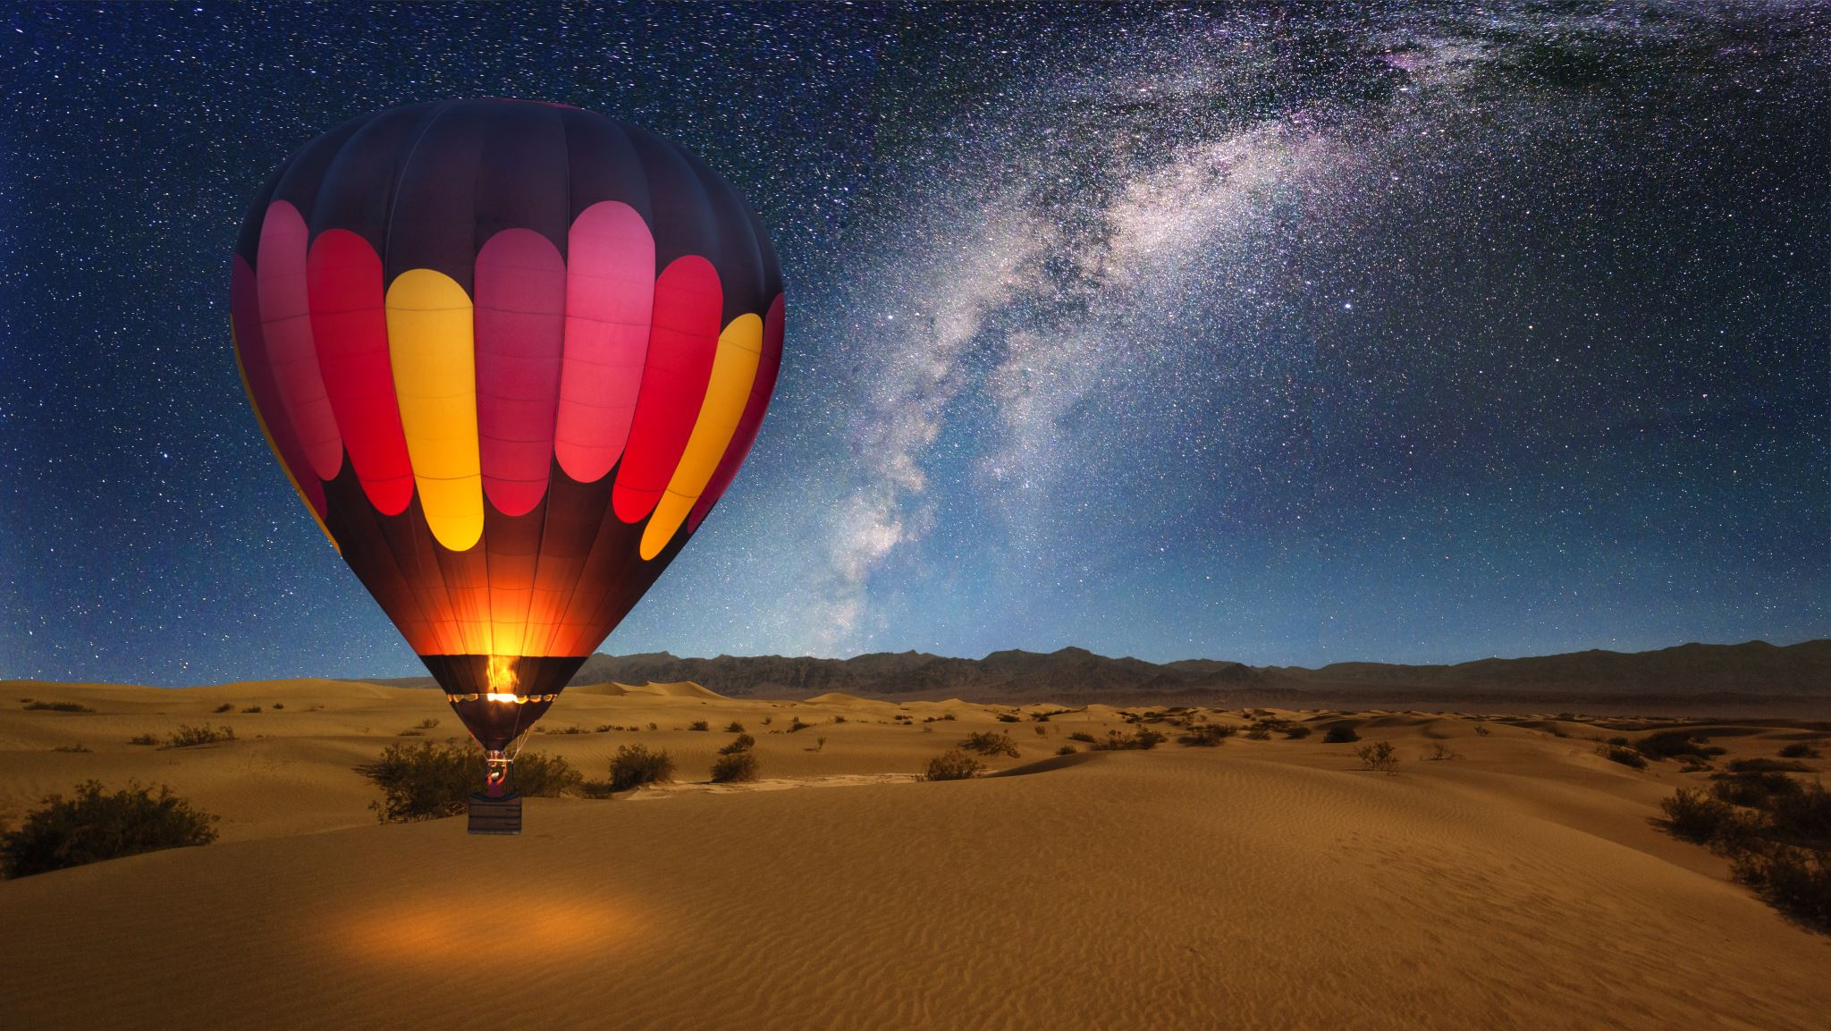
What are you, as the reader going to gain/benefit from this magazine “Galaxy”? What is the ultimate message you are going to take with you?

Slide 7
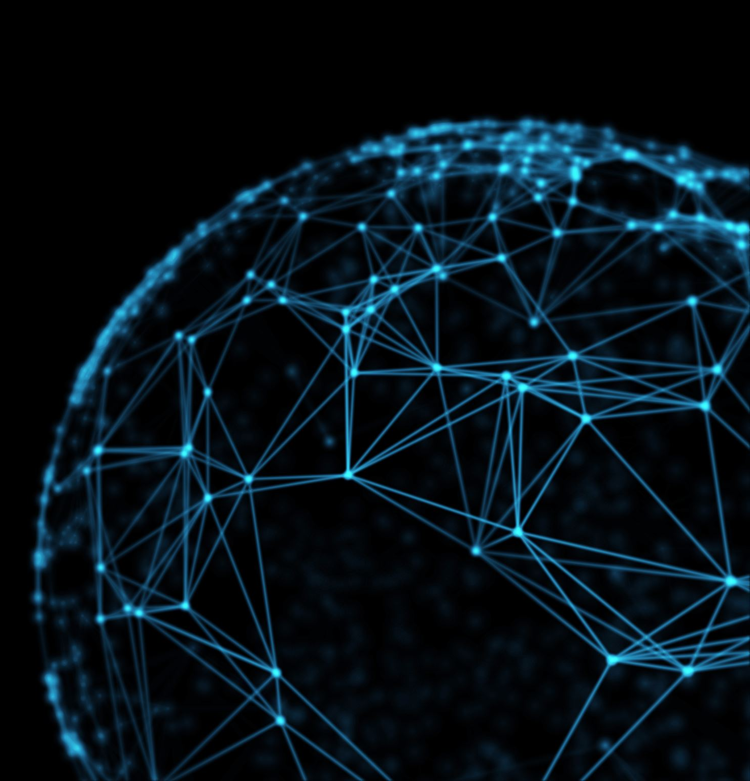
Endless amounts of opportunities and possibilities in the world today. (hence the word galaxy symbolizing endlessness)

Slide 8
Color Scheme

Slide 9

These colors are kind of the colors of a galaxy for example

Slide 10
What would a cover look like?

Slide 11
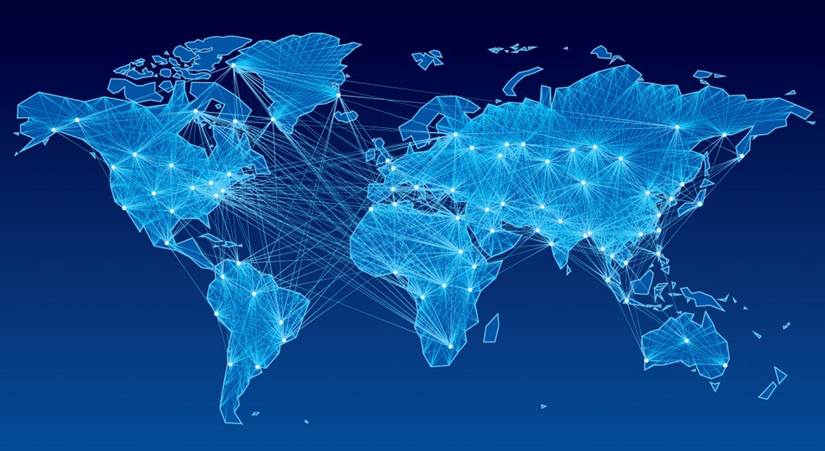

Slide 12
